Slide 1
MOBILE SHOP MANAGEMENT SYSTEM

Slide 2
ABSTRACT
A Mobile shop management system, this project has only one user, the admin is an owner of the shop, login into the application and using all the features. For example, the admin has several shops the single man can’t be handle the all the store in same time but this application can do it. Because this application connects all the store into a single application. He can see all the store details in a single hand. Admin can create a store and login into the application they can entries purchase and sales entry, based on this we can generate billing details, which provide all the details of the application. Which is very important to customize all these features in single application but admin can do this.
The main goal of this project is an connect all the store into a single application and managing all the lifecycle of the project. The project is aimed to develop by JAVA as Front end and SQL as Back end.

Slide 3
HARDWARE SPECFICATION
Processor : P 4 700 GHz.
RAM : 4 GB RAM
Hard Disk Drive : 180 GB

Slide 4
SOFTWARE SPECIFICATION
Operating System : Windows 7/8/10
Front End : JAVA
Back End : SQL

Slide 5
EXISTING SYSTEM
This process can’t help to managing the stock and billing details, these two modules are very important for mobile shop. Which very hard to maintain the shop and no way to store the records in anywhere. But this new system everything has managed by computerized
DRAWBACKS:
The existing system has the following drawbacks.
As storage and exchange of data is achieved only by use of excel sheets which lack validation capabilities, there is always risk of invalid, inaccurate or incomplete data being fed in computer
Difficulty in managing multiple forms.
Lack of issues happen and some products are missing and we can’t find,

Slide 6
PROPOSED SYSTEM
The proposed system is computerized and has been developed using advance language therefore it gives more facilities than present system. It provides quick access to any data. This system easy to track the information about the purchase, sales, stock and billings everything. Customer details also can be managed by this process.
FEATURES:
All the information about sale, purchase will be maintaining properly in this system.
All manual calculation of sale or all the money management will be performed by the computer automatically.
This system will provide timely report information.
It will produce report for sale, bill information.

Slide 7
Modules
Customer Registration
This module collects all the information about the customer like, mobile number, name and address etc… these fields are very help to getting further details about the customer. We can easily find out the regular customers.
Employee Registration
The module will help to store the information about the employees, it collects all the information and store into the employee table. This module collect salary, mobile number etc…

Slide 8
Purchase Mobiles and accessories Product
In this module owner will added purchased mobile phones and accessories. Admin should register before selling that product. Each and every product should enter in this module, then only calculate the stock details if some items are missing to register, we can’t get the exact stock report.
Sales Product
This module has used to register the product details before selling. So, we can identify the stock of product and billing details. Each and every sale will be store in the billing module, when enter the sales that item has reduce in the stock module.
Billing Details
We can calculate billing details based on sales details. This module will generate billing details based on its sales. Billing details has shown the sales product details, it will be showing overall sales details report.

Slide 9

Data Flow Diagram
Level 0

Slide 10
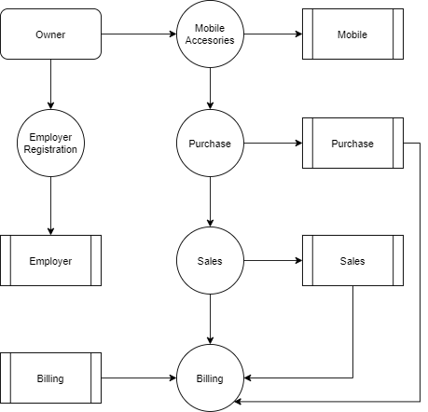
Level 1:

Slide 11
Thank You

